Slide 1
Home Credit Default Risk ML Model: Gradient Boosting Classifier
Omer Yilmaz
University of San Diego
AAI-510
Dr. Kahila Mokhtari
June 2022

Slide 2
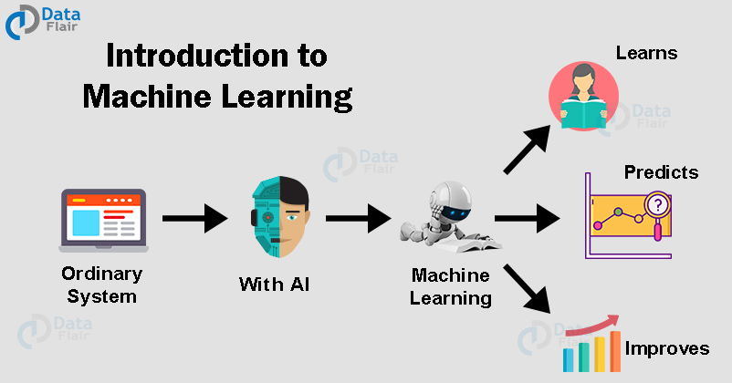
What is Machine Learning (ML) ?
Machine learning (ML) is a type of artificial intelligence (AI) that allows software applications to become more accurate at predicting outcomes without being explicitly programmed to do so. (Burns, n.d.)
machine-learning-tutorial. (n.d.). Retrieved from https://data-flair.training/blogs/machine-learning-tutorial/

Slide 3

Home Credit Default Risk Model
Goal:
A ML Model that approve or decline credit applications based on the multiple source data.
A system that deliver fast results.
Decreasing cost of human made error and human resource
Decreased risk in social, ethical and regulatory risk.

Slide 4
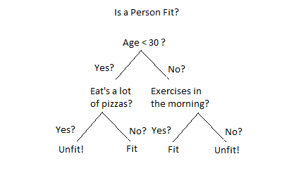
Model: Enhanced Gradient Boosting Classifier
Gradient Boosting Classifier(GBC) is a Decision Tree algorithm.
Decision Trees for Classification: A Machine Learning Algorithm. (n.d.). Retrieved from https://www.xoriant.com/blog/decision-trees-for-classification-a-machine-learning-algorithm

Slide 5
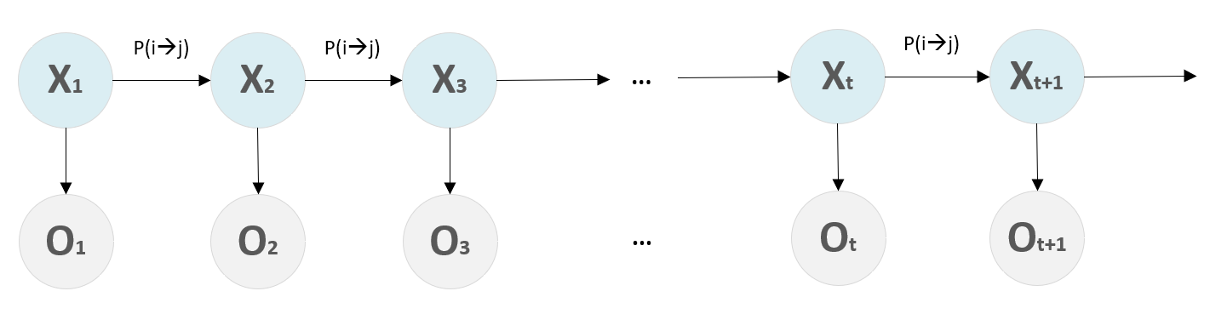
Hidden Markov Model
Hidden Markov Models (HMMs) are a class of probabilistic graphical model that allow us to predict a sequence of unknown (hidden) variables from a set of observed variables(Dorairaj, n.d.).
Hidden Markov Models (HMMs). (n.d.). Retrieved from https://subscription.packtpub.com/book/big-data-&-business-intelligence/9781788621113/4/ch04lvl1sec27/hidden-markov-models-hmms

Slide 6
Why GBC with HMM?
Works fast. It means consume less resources.
Best resulting algorithm for dataset.
Suitable for enhancement with Hidden Markov Model.
HMM brings information from previous application data.

Slide 7
How is it works ?
HMM retrieve information from previous application.
HMM also gather prediction from time series data such as bureau balance.
After that dataset prepared for mathematical transformations.
Then with combined application dataset and HMM result become an input for GBC.
Finally, GBC predict application an output as approved or declined.

Slide 8
Model is a faster solution
Model do not sleep, works 24/7.
Model resources can increase or decrease depend on demand.

Slide 9
Decreased risk in social and ethical.
Model don’t have feelings.
Consider every application equally.
Don’t distract with human’s instant feelings.
Model don’t have prejudice.
Don’t consider applicant with any idea of relational, political etc.
Model don’t give any privilege because of statue.

Slide 10
Decreased risk in regulatory risk
Model don’t forget any law. Everything set and saved.
1
Model don’t show any flexibility about law to any applicant.
2
Model uses edge cutting cloud services to prevent security vulnerabilities.
3

Slide 11
References
Burns, E. (n.d.). Machine Learning. Retrieved from https://www.techtarget.com/searchenterpriseai/definition/machine-learning-ML
Decision Trees for Classification: A Machine Learning Algorithm. (n.d.). Retrieved from https://www.xoriant.com/blog/decision-trees-for-classification-a-machine-learning-algorithm
Dorairaj, S. (n.d.). Hidden Markov Models Simplified. Retrieved from https://medium.com/@postsanjay/hidden-markov-models-simplified-c3f58728caab
Hidden Markov Models (HMMs). (n.d.). Retrieved fBurns, E. (n.d.). Machine Learning. Retrieved from https://www.techtarget.com/searchenterpriseai/definition/machine-learning-ML
Decision Trees for Classification: A Machine Learning Algorithm. (n.d.). Retrieved from https://www.xoriant.com/blog/decision-trees-for-classification-a-machine-learning-algorithm
Dorairaj, S. (n.d.). Hidden Markov Models Simplified. Retrieved from https://medium.com/@postsanjay/hidden-markov-models-simplified-c3f58728caab
Hidden Markov Models (HMMs). (n.d.). Retrieved from https://subscription.packtpub.com/book/big-data-&-business-intelligence/9781788621113/4/ch04lvl1sec27/hidden-markov-models-hmms
machine-learning-tutorial. (n.d.). Retrieved from https://data-flair.training/blogs/machine-learning-tutorial/
rom https://subscription.packtpub.com/book/big-data-&-business-intelligence/9781788621113/4/ch04lvl1sec27/hidden-markov-models-hmms
machine-learning-tutorial. (n.d.). Retrieved from https://data-flair.training/blogs/machine-learning-tutorial/

